Slide 1
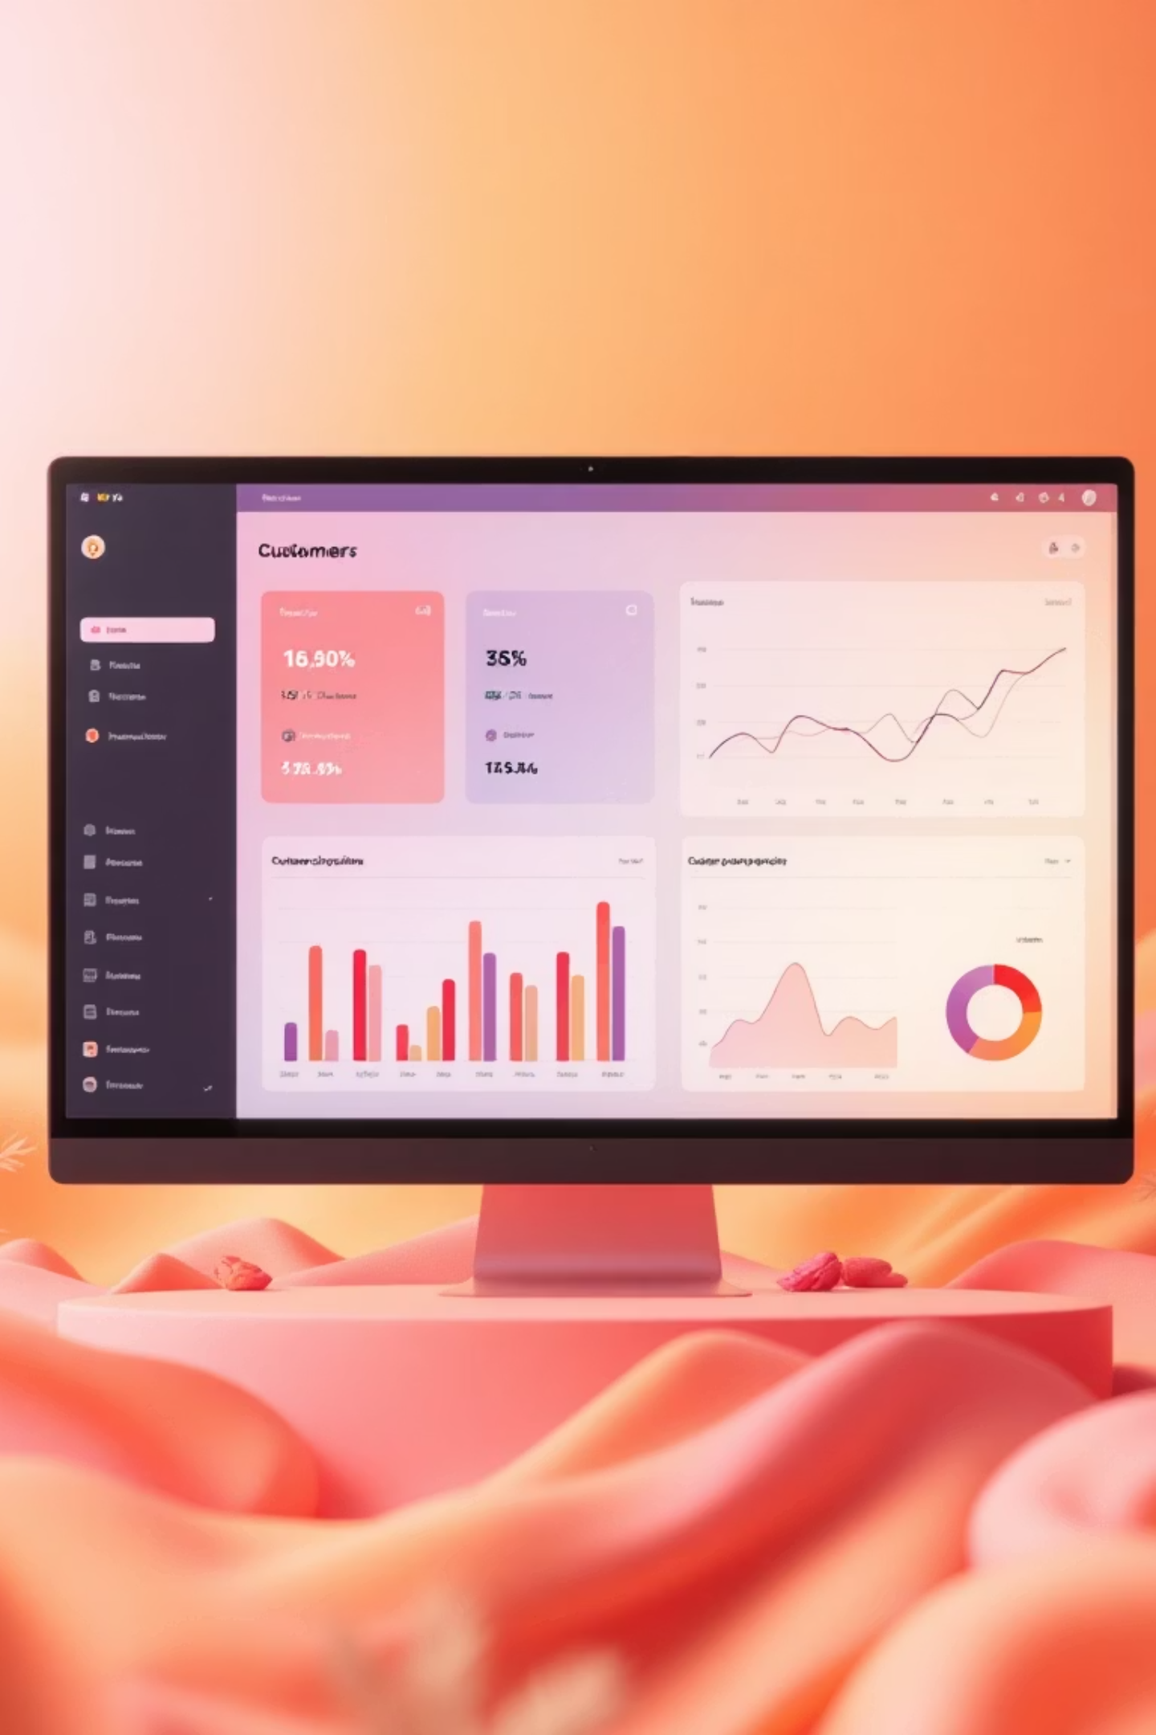
Customer Shopping Behavior Dashboard
Unlocking growth opportunities through data-driven decisions.

Slide 2

Age Group & Revenue Contribution
Top Contributors
Young Adult & Middle-aged customers generate the highest revenue.
Lowest Contribution
Senior customers contribute the least to total revenue.
Implication: Focus marketing efforts on Young Adult and Middle-aged segments for maximum ROI.

Slide 3

Product Categories: Sales & Revenue Drivers
1
Clothing Dominates
Top contributor in both sales volume and revenue.
2
Accessories
Second highest in sales and revenue.
3
Footwear
Strong third place performer.
Implication: Treat Clothing as a core business category with higher inventory, focused promotions, and increased advertising.

Slide 4


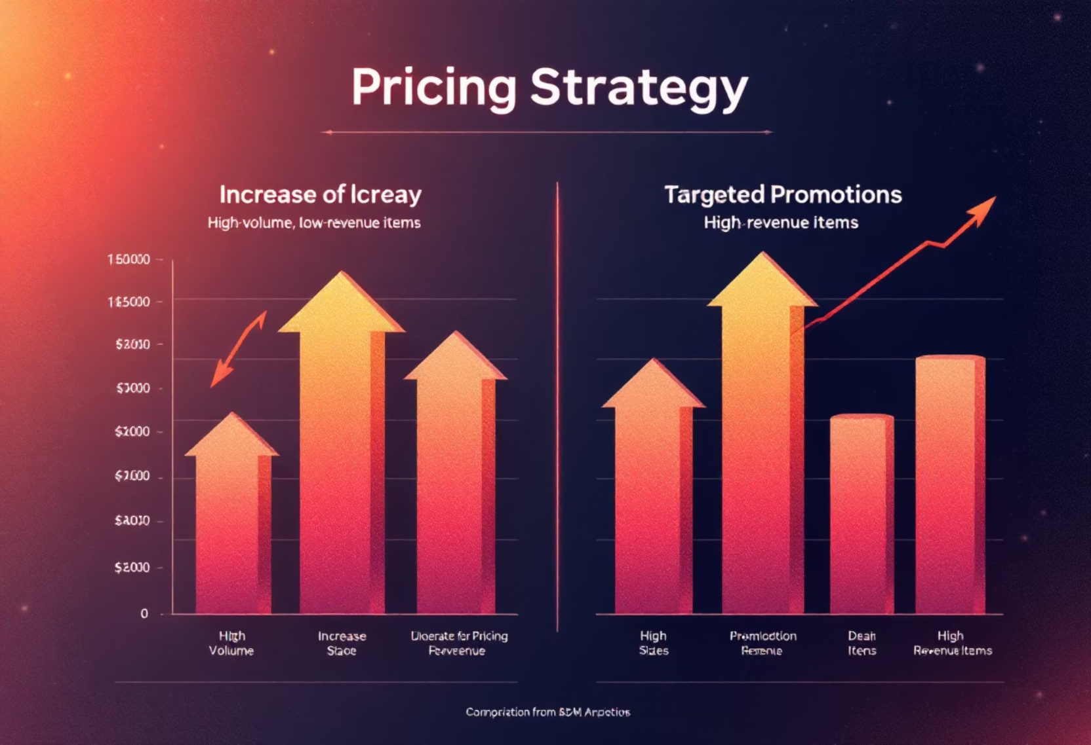

Optimizing Pricing & Loyalty
Pricing Opportunity
Customer Loyalty Pattern
High volume, low revenue vs. high revenue, fewer sales. Adjust prices strategically.
Majority are loyal and returning customers. New acquisition is low.
Implication: Increase prices for high-volume products. Strengthen referral programs and loyalty initiatives for new customer acquisition.

Slide 5



Product Ratings Drive Sales
3.7-3.8
Avg. Rating
Overall average product review rating.
⬆️
Higher Ratings
Correlate with better sales performance.
Conclusion: Encourage customer reviews, highlight top-rated products to build trust and boost sales. This Power BI analysis reveals clear pathways for business growth.

